Slide 1
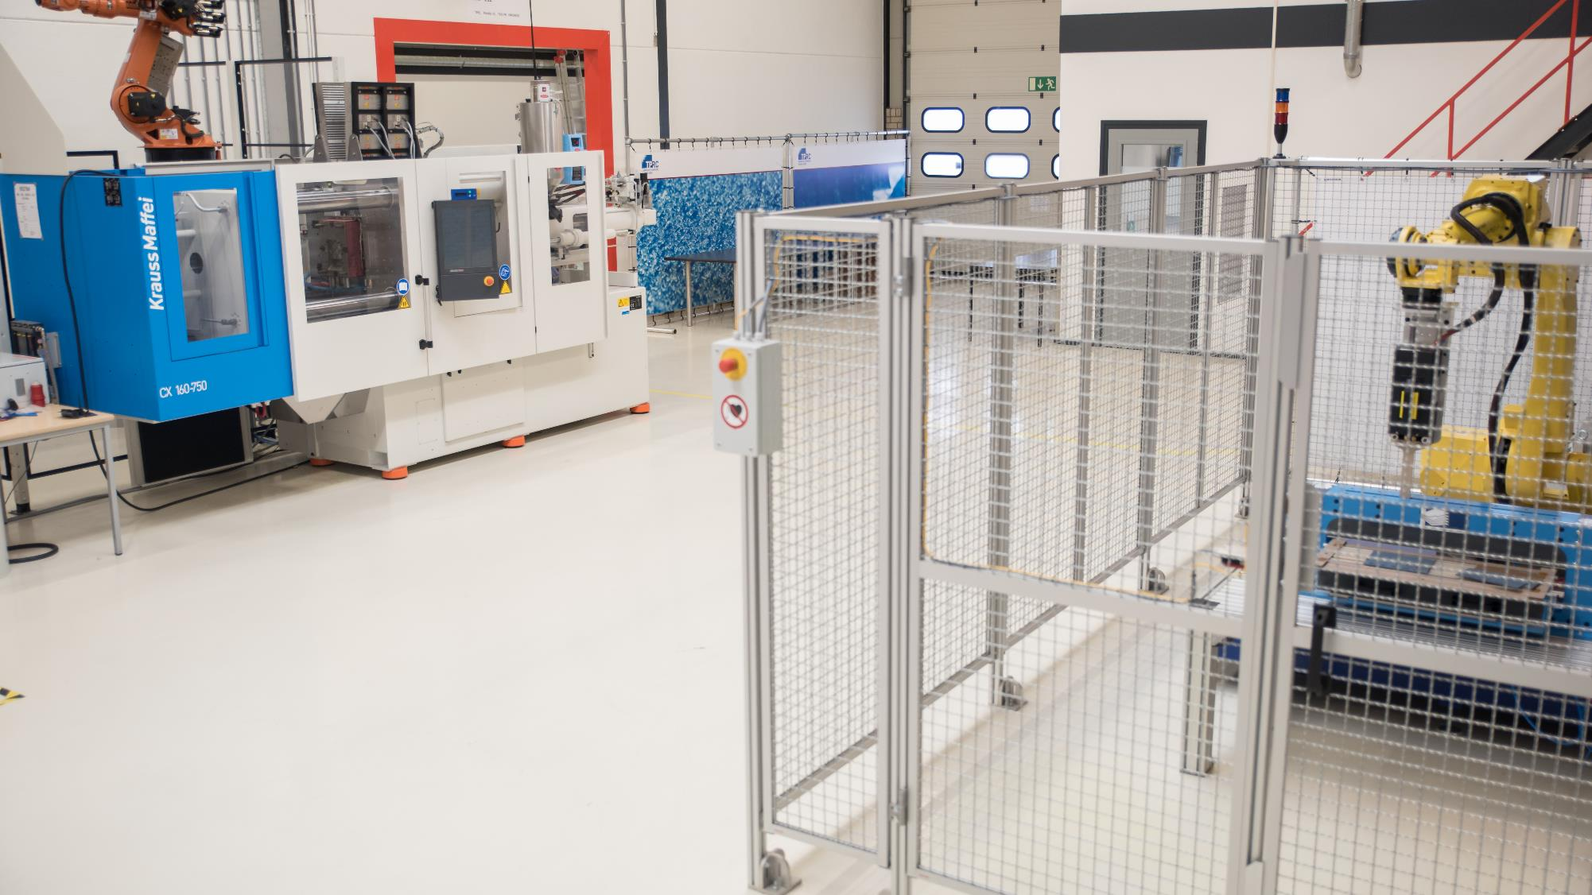

Processing of advanced thermoplastic composites
DOMMINIO workshop, November 30th, 2021

Slide 2
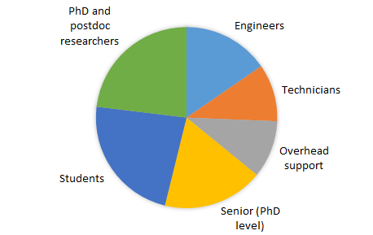
thermoplastic composites research center
Key figures 2020
Staff | 30
Graduates | 5 - 10
Budget | 2.3 M€
Members | 22 (13 T1 & 9 T2)

Slide 3





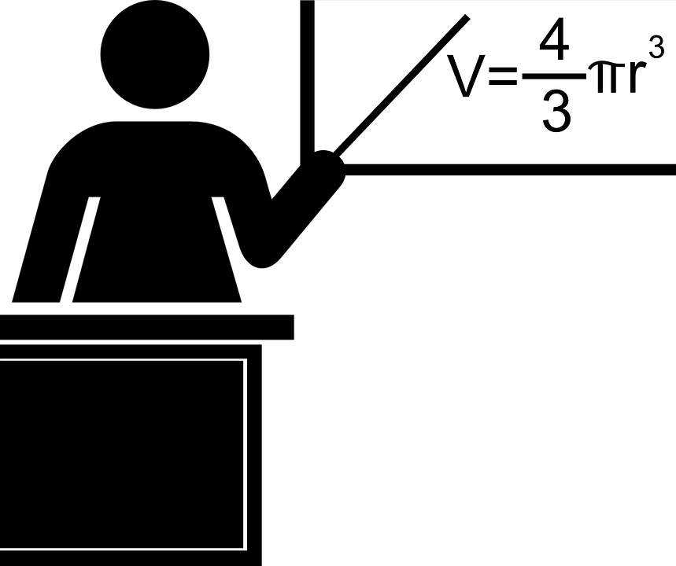


Organisation
members
TPRC Foundation
IP
tier 1
tier 2
IP
roadmap research
bilateral projects
training
non-member

Slide 4



thermoplastic composites research center
Cooperation models
Membership
  Definition & steering of roadmap research
  Generated IP is shared amongst members
  Attractive access to facilities
Bi- and multilateral projects
  Members and non-members
  Goal: initiate long term cooperation
Training
  Introductory course on Thermoplastic Composites
  Advanced level course on Forming of Thermoplastic Composites
  Joining of Thermoplastic Composites (under construction)

Slide 5
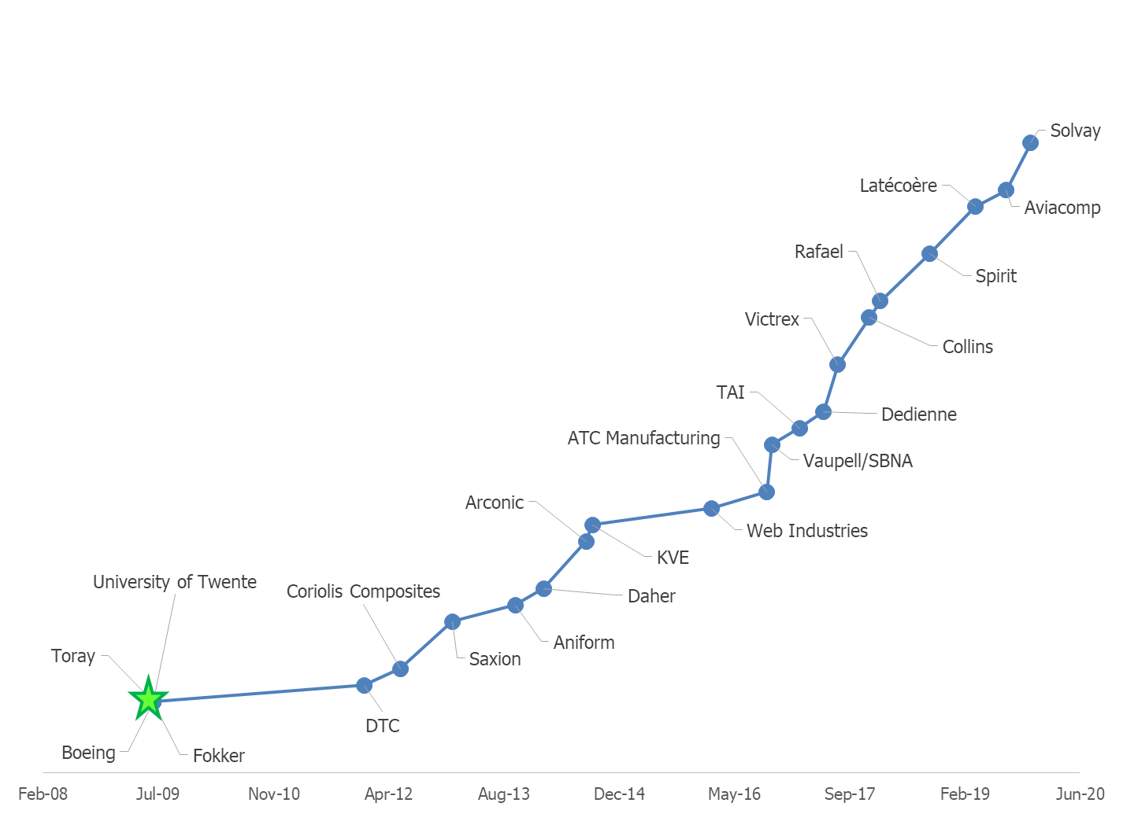






















Members of tprc
Growth since 2009

Slide 6


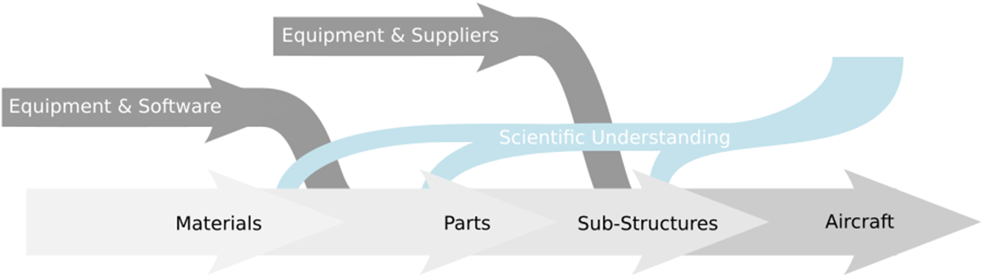














Members of tprc
Value chain approach

Slide 7
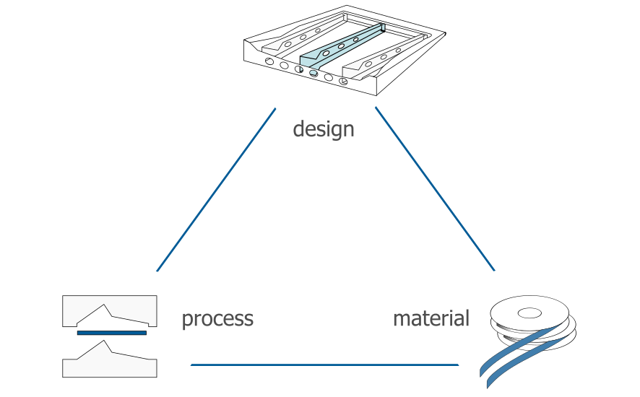
TPRC research roadmap
tool design & engineering
materials database
virtual process optimization
processing technologies
AFP
press-forming
autoclave
overmolding
welding
current ROADMAP focus
characterization capability
material design guidelines
process simulation
material – process interaction

Slide 8
Current roadmap projects

Slide 9
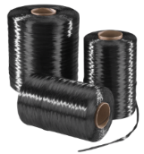
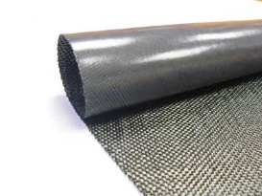
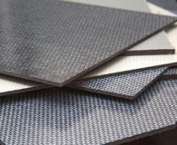
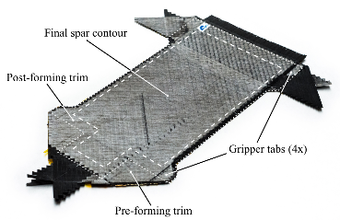
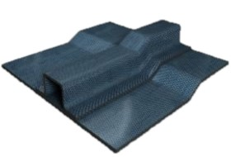
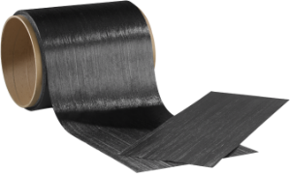
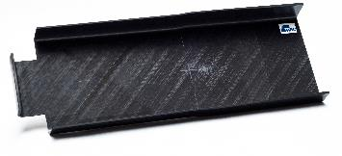
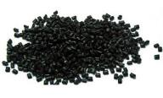
TPRC research roadmap
From prepreg to structure
raw materials
pre-preg
laminate
(tailored) blank
component
assembly

Slide 10
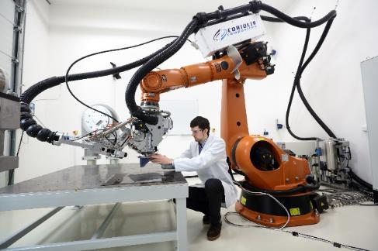
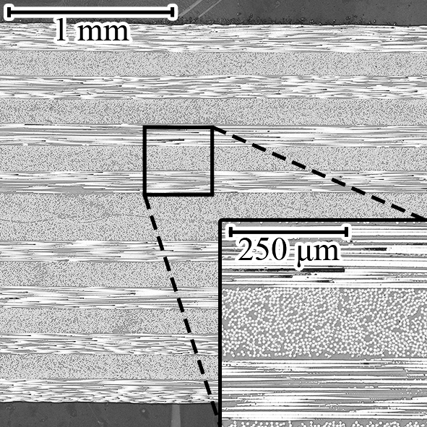
TPRC research roadmap
From prepreg to structure
raw materials
pre-preg
laminate
(tailored) blank
component
assembly
Consolidation
Autoclave and vacuum-bag-only
In-situ AFP
AFP + out-of-autoclave
Notes:
including machine learning

Slide 11
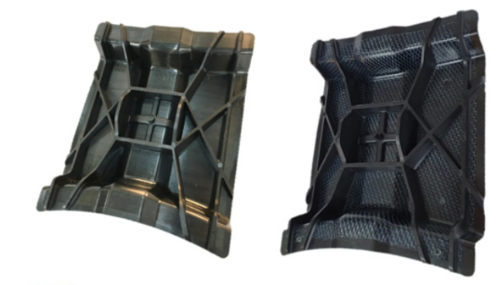
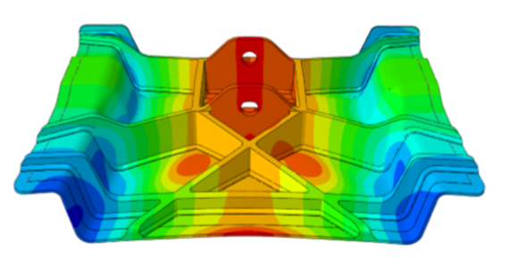
TPRC research roadmap
From prepreg to structure
raw materials
pre-preg
laminate
(tailored) blank
(tailored) blank
component
assembly
Forming
Advanced simulation
Tailored blanks stamping
Injection overmolding
Notes:
advanced data analysis

Slide 12
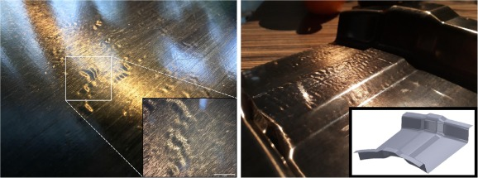
TPRC research roadmap
From prepreg to structure
raw materials
pre-preg
laminate
(tailored) blank
component
assembly
Process – performance interaction
Thermal stability
Creep & long term performance
Defect free manufacturing

Slide 13
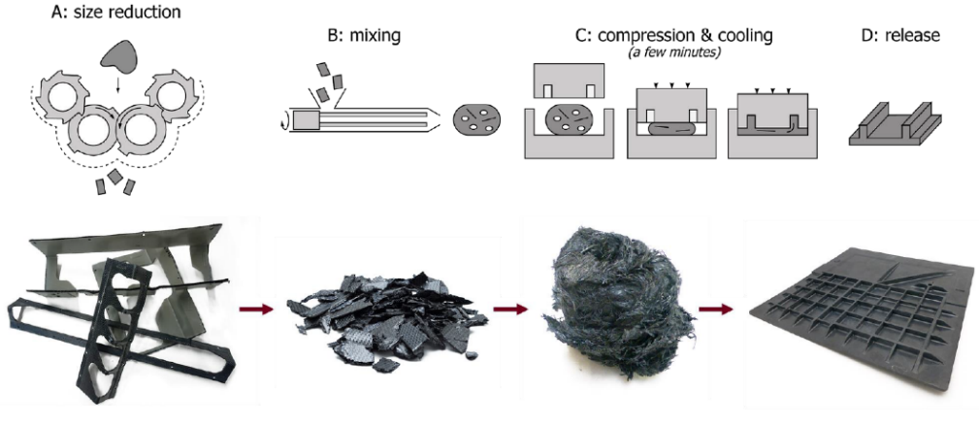
TPRC research roadmap
From prepreg to structure
raw materials
pre-preg
laminate
(tailored) blank
component
assembly
Recycling
Re-use of process reclaim
Compression moulding

Slide 14
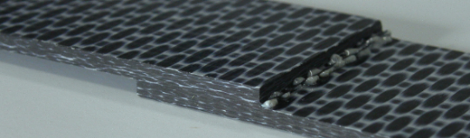
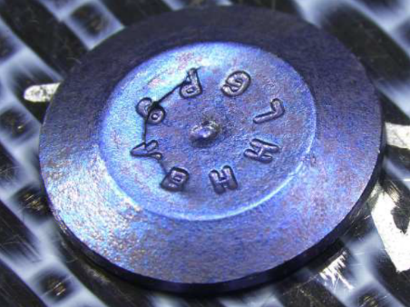
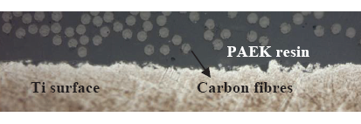
TPRC research roadmap
From prepreg to structure
raw materials
pre-preg
laminate
(tailored) blank
component
assembly
Joining
Welding
Multimaterial, hybrid joining
Mechanical fastening

Slide 15
ENLIGHTEN

Slide 16

ENLIGHTEN
Enabling Integrated Lightweight Structures In High Volumes (ENLIGHTEN)
Goal: Enhance assembly and integrated manufacturing of TPC structures
Means: Accurate material, process and performance modelling, combined with well controlled and monitored manufacturing processes, leading to predictable structural performance
NWO Perspective
  5 years, project budget €5.600.000
  13 PhD
  University of Twente, Delft Technical University, Technical University of Eindhoven, Warwick Manufacturing Group, TPAC (Saxion)

Slide 17
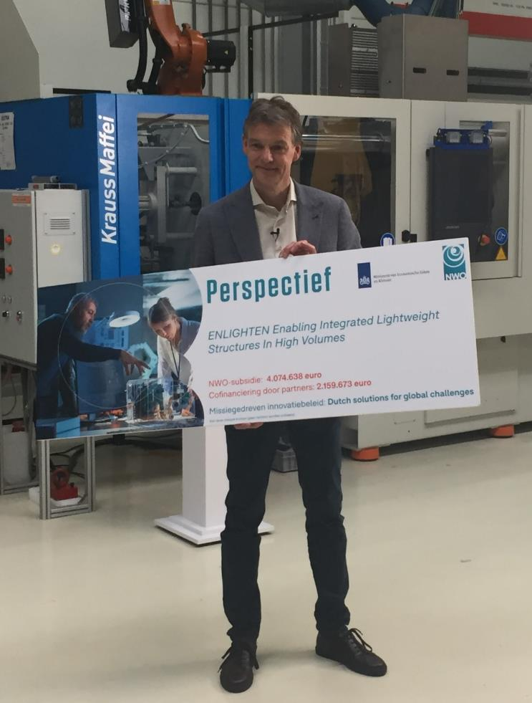
ENLIGHTEN
Enabling Integrated Lightweight Structures In High Volumes (ENLIGHTEN)
Goal: Enhance assembly and integrated manufacturing of TPC structures
Means: Accurate material, process and performance modelling, combined with well controlled and monitored manufacturing processes, leading to predictable structural performance
NWO Perspective
  5 years, project budget €5.600.000
  13 PhD
  University of Twente, Delft Technical University, Technical University of Eindhoven, Warwick Manufacturing Group, TPAC (Saxion)

Slide 18
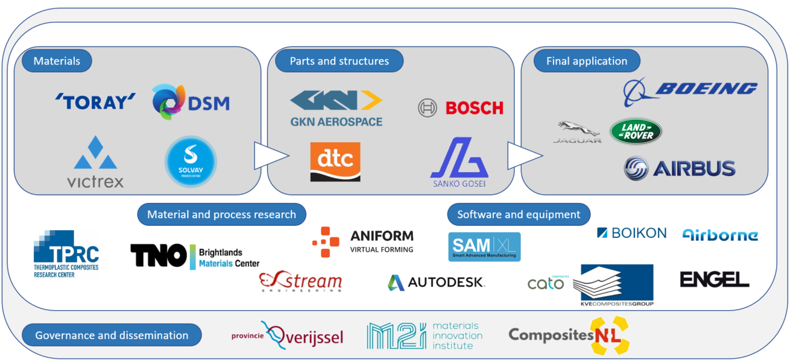
ENLIGHTEN

Slide 19
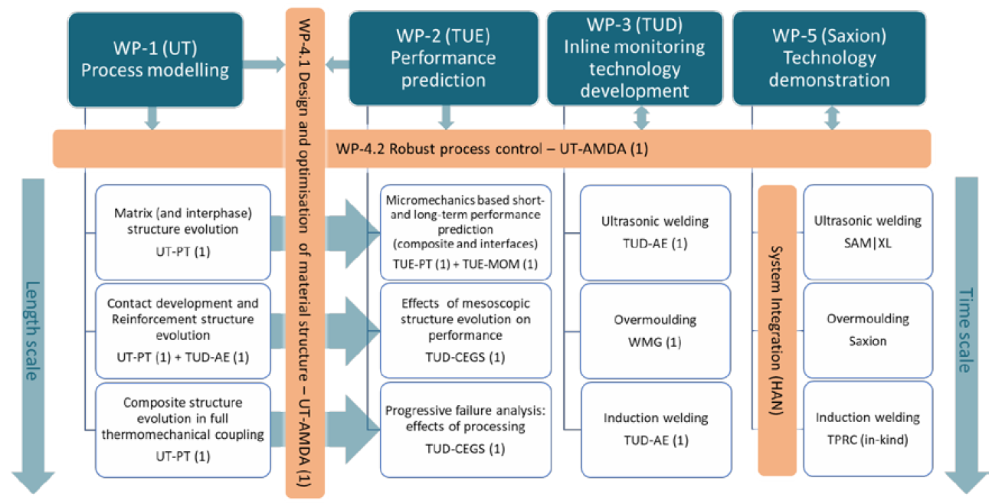
ENLIGHTEN

Slide 20
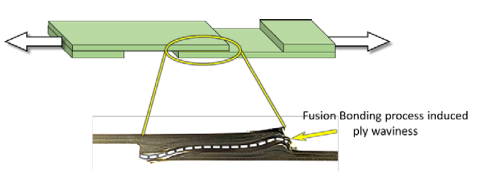
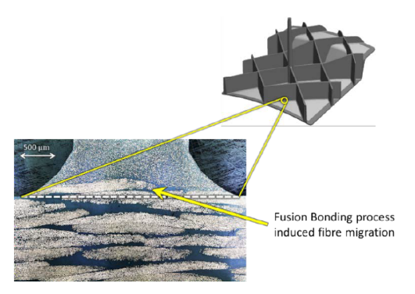
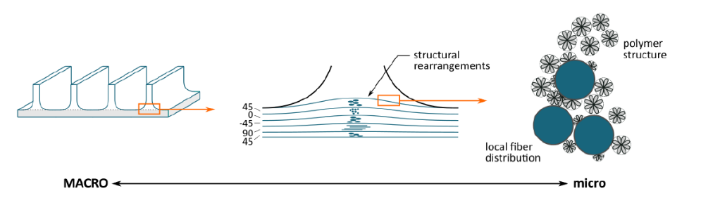
ENLIGHTEN
3 PhD students at UT/TPRC on process modelling
Matrix and interphase structure evolution
  healing - crystallization
  morphology – performance
Contact development and reinforcement structure evolution
  restructuring via non-isothermal multiphase flow
  de- and re-consolidation
  induction welding and overmolding
Composite structure evolution in full thermomechanical coupling
  physically based homogenized constitutive models

Slide 21
Closure

Slide 22
Summary
Basic research runs along with the commercialisation of thermoplastic composites
TPRC’s roadmap research currently focuses on material – process interaction
Understanding of basic mechanisms required prior to upscaling

